Slide 1
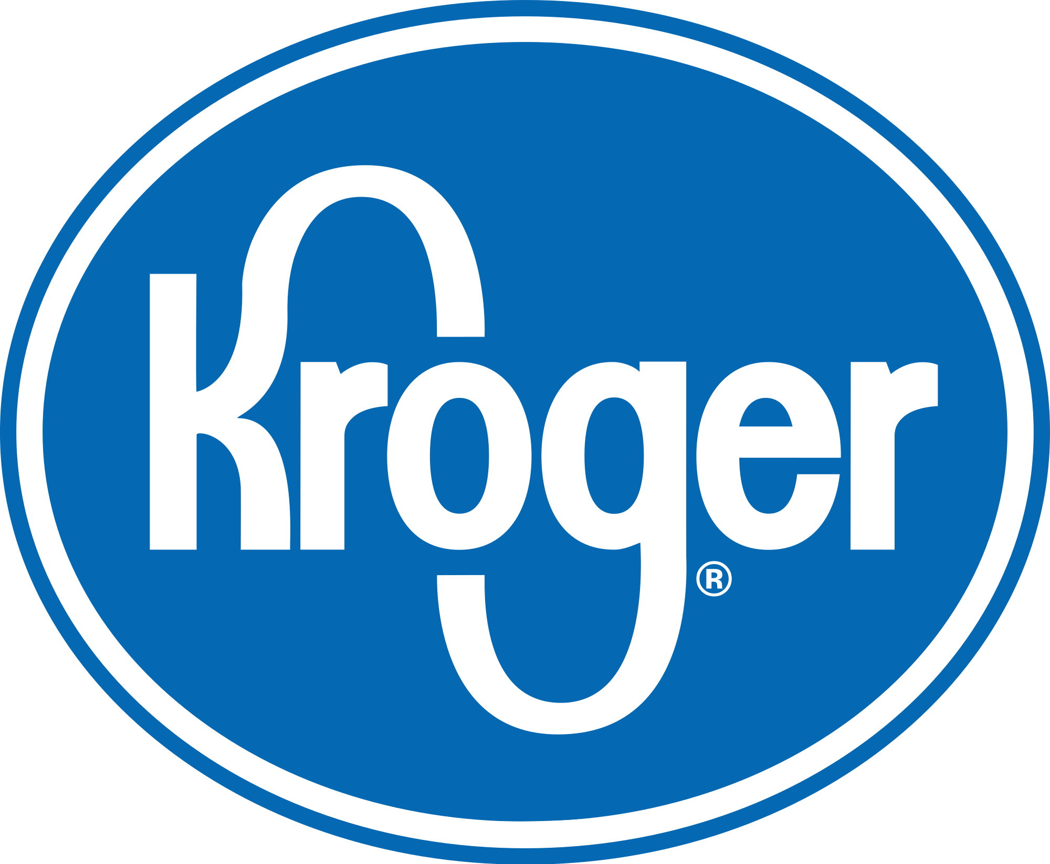
Kroger Uses Simulation-Optimization to Improve Pharmacy Inventory Management
Team C: Sai Prabhath Kollimarla, Ziyi Huang, Ying Wu, Peiyan Yu, Wanxin Zhang

Slide 2
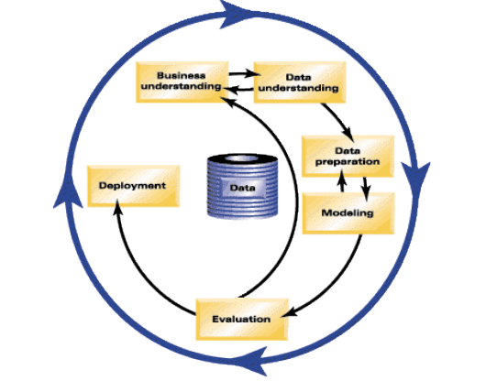
Business Understanding

Slide 3
About Kroger
Largest traditional grocery retailer
Customer first approach
11% of profits to charity

Slide 4

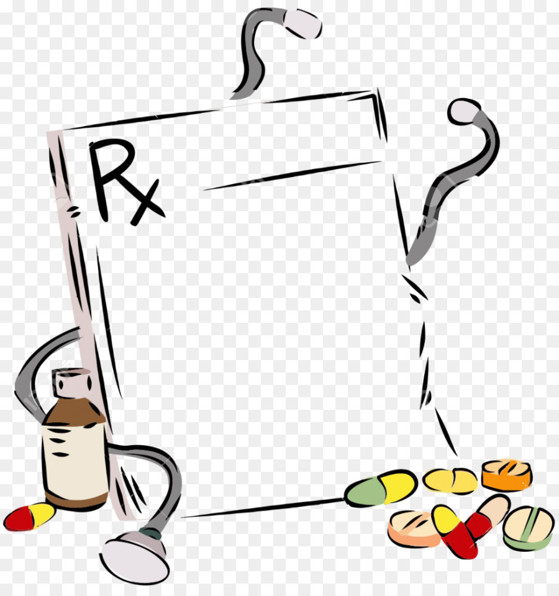

Kroger Pharmacies
1950+ outlets
160 Million prescriptions
$8 Billion Revenue

Slide 5
Business characteristics
Pharmacies have:
Seasonal demand
Demographically variable demand
High variability in inventory
Unpredictable lead times

Slide 6
Challenges
Regulation Changes
Affordable Care Act
Express Scripts unacceptance
Patent expiration on many drugs

Slide 7
Objective
Decrease Inventory Capital
Lower inventory costs
Comprehensive Inventory Management system
Reduce Out-of-stock
Reduce time on Inventory Management

Slide 8
Data Understanding

Slide 9
Describing Data
Verifying Data Quality
01
02
03
04
Collecting Initial Data
Explore the Data

Slide 10
Collecting Initial Data
Drug Information
Inventory Policy
Process Simulation
Drug Code
Total Demand
Package Size
No. of days with prescription
Reorder Point
Order-up-to level
Query ID
Date
Demand
Days of week
Ordering period
…

Slide 11
Data Description
All of the data come from historical transactions of Kroger pharmacy that are contains 440 days‘ data, in order to cover all seasons.
Numeric
Simulation Process
Drug Information
Inventory Process
Date
Date

Slide 12
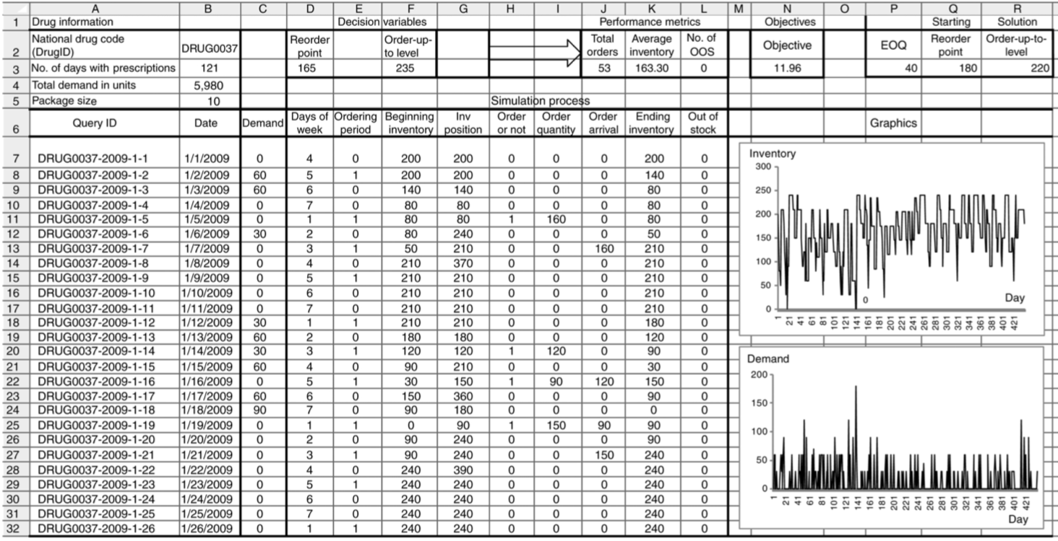
Sample of Spreadsheet

Slide 13
Exploring Data and Verifying Data Quality
Sufficient data about transactions, good for us to explore and find the best result.
Most of data are automatically obtained from the sales system, not so many missing data and errors.
The dataset is good to create spreadsheet models and simulation- optimization model for Kroger.

Slide 14
Back to
Understand the business

Slide 15
Understand the business again
Project Challenges:
Business resistance to complicated models
Traditional models are based on rather standard distributions
Adjusted Objective:
Minimize long-run cost and keep inventory performance level
Model is easy to understand, easy to adjust, quick to use

Slide 16
Modeling

Slide 17
Modeling
Part I
Part II
Simulation
Optimization
Spreadsheet Models for Inventory Management
Local Search Algorithm to Optimize the Inventory System

Slide 18
Part I. Simulation
‘The beauty of simulation is that it provided a test ground we could test with our pharmacy corporate peers. We could review the differences between what we had and what was already in production. ’
--Doug Meiser,Kroger manager

Slide 19
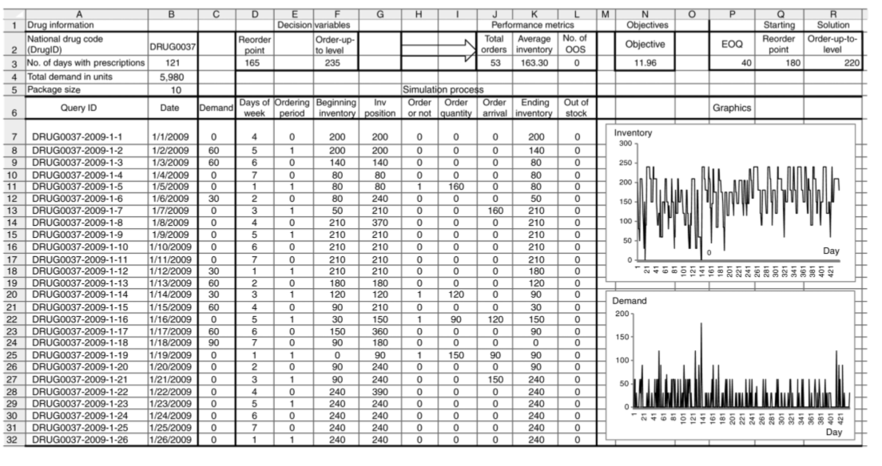
Reorder Point & Order Level
Performance Metrics
Demand
Query ID, Date
Simulation Process:
Given historical demand data,
Set reorder point and order level as objective variable,
Simulate the inventory positions

Slide 20
Part II. Optimization
Objective:
Minimize the long-run average costs under an (s,S) policy
Objective Function:
Offered by Simulation Performance metrics

Slide 21
Optimization Method: Local Search Algorithm
Simplex LP?
GRG Non-linear?
Local Search Algorithms
Not Convex.
Method needs to be simple and fast.
Only 3 Steps.
Fast but effective.

Slide 22
Optimization Method: Local Search Algorithm
Move 1
Move 2
Move 3
Increase or decrease (s,S) together by equal amount
Increase s but keep S unchanged to decrease order size Q
Increase S and keep s unchanged to increase order size Q
Salient feature:
Selection of neighbor solutions based on simulation results

Slide 23
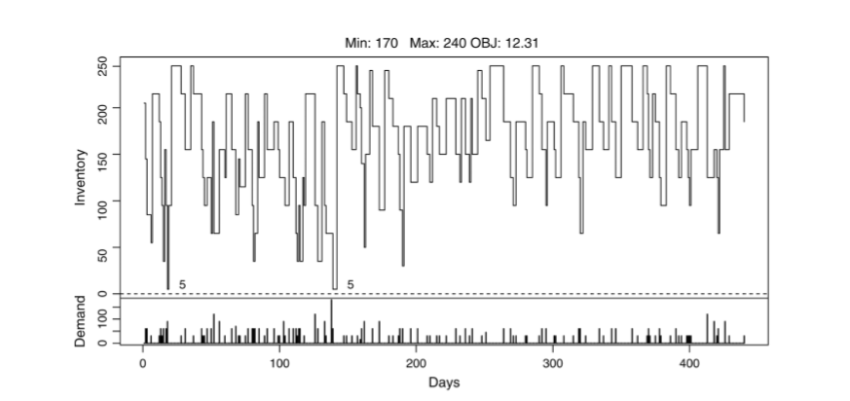
Example: (s, S) = (170, 240)
All ending inventory levels are > 0
Suggests move (s, S) upward, keep Q the same

Slide 24
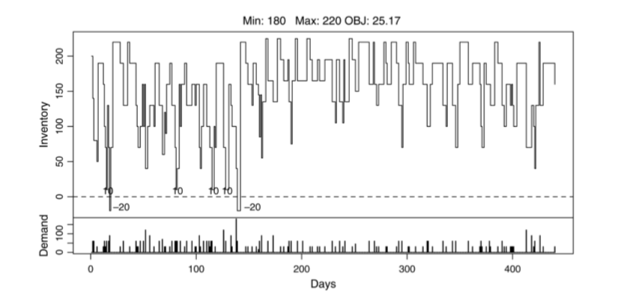
Example: (s, S) = (180, 220)
With Q = 40:
Suggests either increase s by 20 units,
Or Decrease S by 10 units

Slide 25
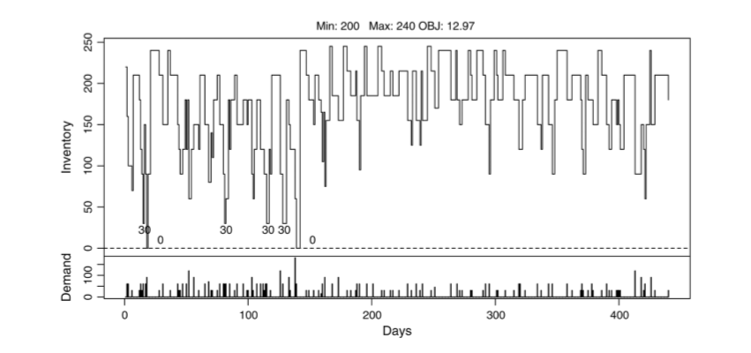
Example: (s, S) = (200, 240)
With Objective value=12.97, Minimum inventory is 30
Suggests reduce Q to 30

Slide 26
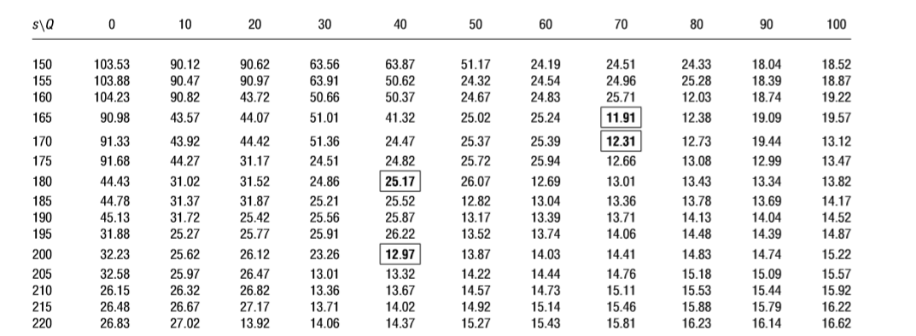
Objective values under different policies

Slide 27
Modeling Summary
Part I
Part II
Used historical data instead of standard distribution for simulation
3-step local search optimization method
Quick and easy to use
Simulation
Optimization
Spreadsheet Models for Inventory Management
Local Search Algorithm to Optimize the Inventory System

Slide 28
Modeling Summary
Used historical data instead of standard distribution for simulation
3-step local search optimization method
Quick and easy to use

Slide 29
Evaluation

Slide 30
CRISM DM Stage 5 - Evaluation
Overwhelmingly positive results
Yield great tangible benefits
Brought valuable intangible benefits

Slide 31
Overwhelmingly Positive
Achieved our business goal in inventory management
-Easy for business people to accept
-Leverage computational capabilities and algorithms
-Effective and Intuitive approach
Approach comparison
Model Transportability and Operations Research Advances

Slide 32
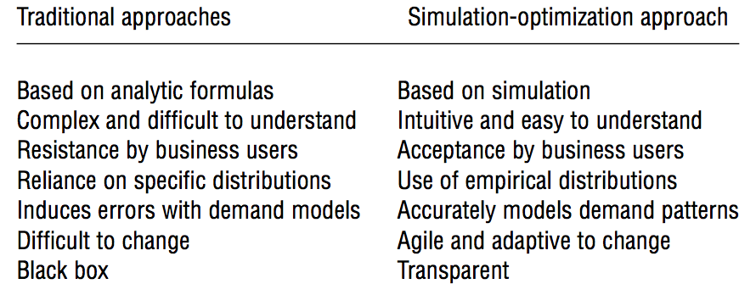
Approaches Comparison

Slide 33
Yields great tangible benefits
Inventory Reduction ($120 million)
Additional Revenues of $80 millions annually
Labor savings of $10 millions per year (partially filled prescription)

Slide 34
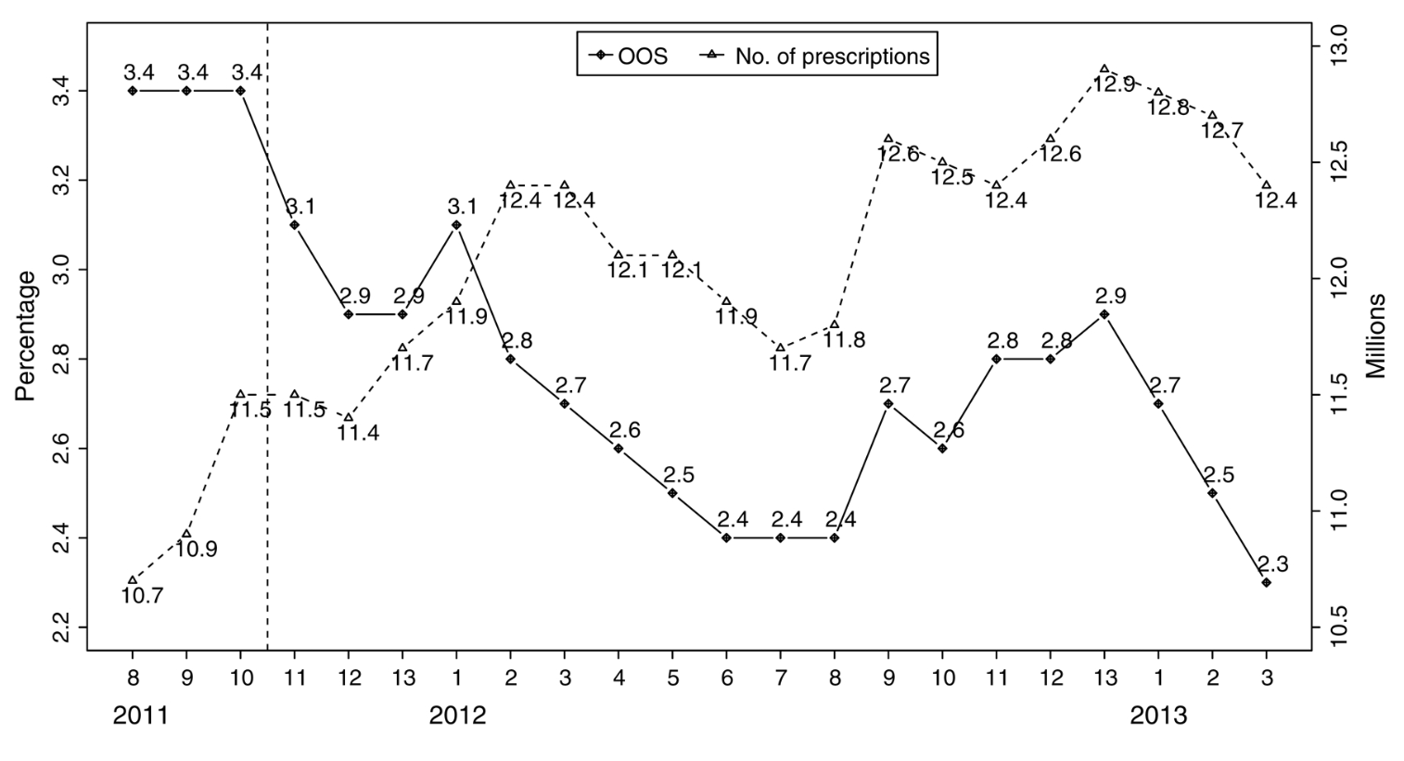

Slide 35
Bring valuable intangible benefits
improved customer service – ensure greater access to medication
key to retaining customer loyalty and driving future growth
strong foundation to extending the model for meat and seafood
OR as core competency and competitive advantages

Slide 36
Deployment

Slide 37
Business acceptance
Easy to understand
Transparent
Test
Accurately model demand
Fast and agile to change
Simulation based Approach
Notes:
Dennis (speaker) leads a team to support operations of 1950 pharmacies .
They need to make sure the model can be explained in a simple way to associates who order products.
Test ideas ahead of time can avoid risk and cost of a live trial.

Slide 38


Simulation model
Managers have some good ideas
Operation research team works on model
Pharmacists and associates use it if applied
Notes:
Test good ideas ahead of time and avoid risk and cost of a live trial.
Some ideas they came up actually don’t work well.

Slide 39
Enterprise Deployment
1
2
3
4
Started in October, 2011
Central pharmacy system
6 divisions every 2 weeks
Fortuitous time point
Notes:
Roll out 6 divisions every two weeks help the warehouse to regain the inventory and avoid out of stock.
It’s a lucky point because the competitors announced they wouldn’t accept the Express scripts any more( a prescription insurance company). This will turn away patients.
Kroger gained a large amount of patients in a very short time. The simulation tool help they deal with this extreme demand situation and retain customers.

Slide 40
Application
Inventory applications in other departments: such as meat and seafood.
Goal: Minimize spoilage and out of stock.
Combine with other R&D systems like real-time POS.
Pilot the new inventory solution in 25 stores
Future: since it’s transportable, can extend to other parts of medical industry or many other industries.
Notes:
They combine model with regression for each product.

Slide 41
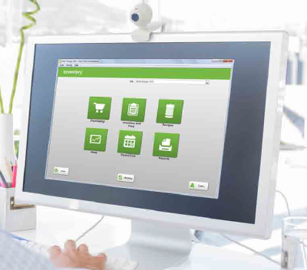
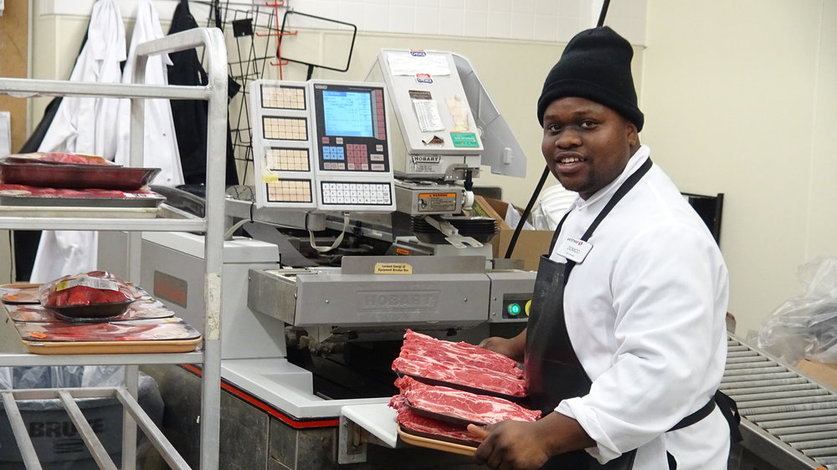
Live inventory counts and real-time recommendations(of cut)

Slide 42
Speakers in the video
Start and end with videos
High quality videos from other members
Emphasize their focus: customer

Slide 43
Thanks for listening
Q&A

